Slide 1
CSE4/510 Project
UAV Learning to Fly
Rugved Hattekar
Nanditha Nandanavanam
Chen Zeng

Slide 2
Objectives
This project aims to apply a reinforcement learning pipeline on a quadcopter dynamics to function as the controller that is capable of performing takeoff, landing, and stable hovering.
Based on a commercial platform (Crazyflie 2.0)
Simulated flight dynamics in ROS environment
DoE & RL training for taking off and hovering (separately)

Slide 3
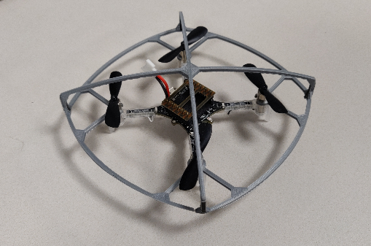
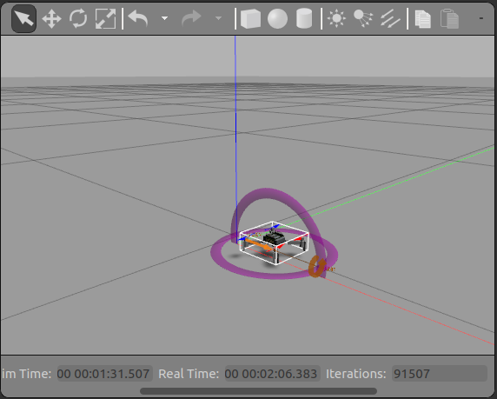
The Platform
Hardware: Crazyflie 2.0
Software (planned): Gazebo Simulator
Weights below 35g
Integrated sensors and controllers
Open-source controller and SDK
Works in ROS environment
Existing packages (CrazyS) for dynamics simulation of Crazyflie

Slide 4
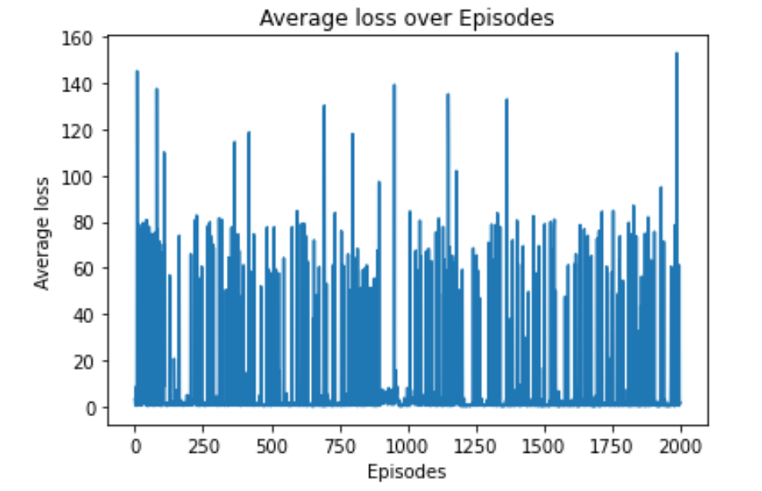
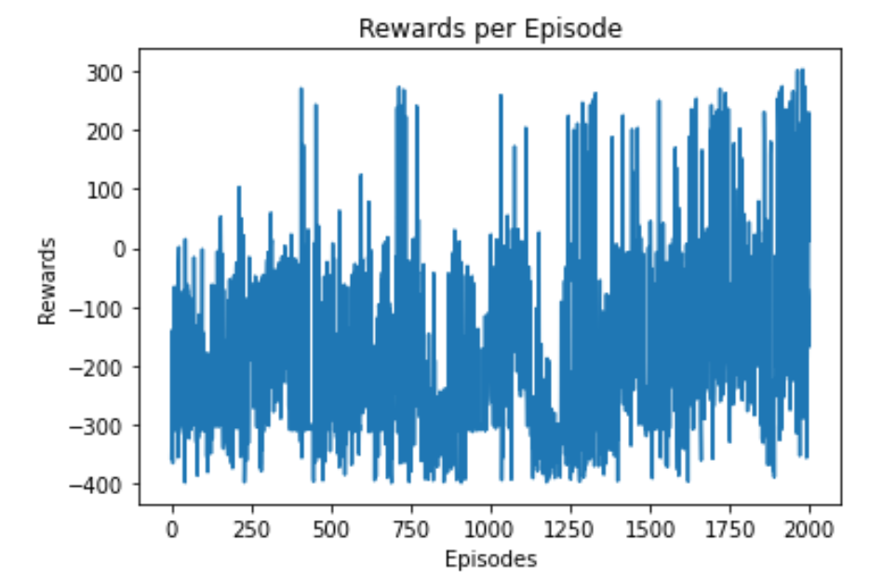
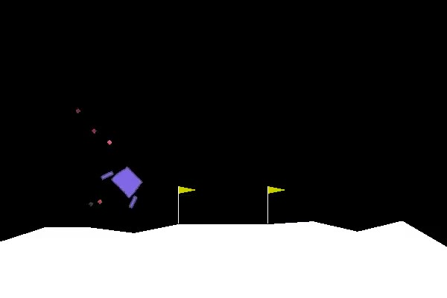
Preliminary Progress (Checkpoint)
Setting up Gazebo environment is more time-consuming …
Lunar Landing Problem chosen as the preliminary test problem
DQN applied, results not promising
Learning rate = 0.001
Epsilon = 0.7
Epsilon decay = 0.995
Number of episodes = 5000
Discount factor = 0.98

Slide 5
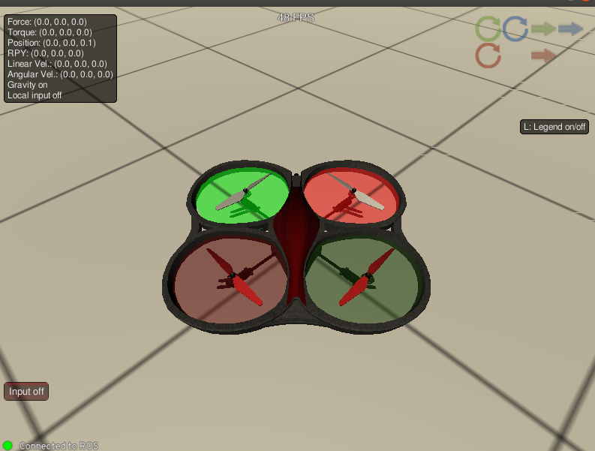
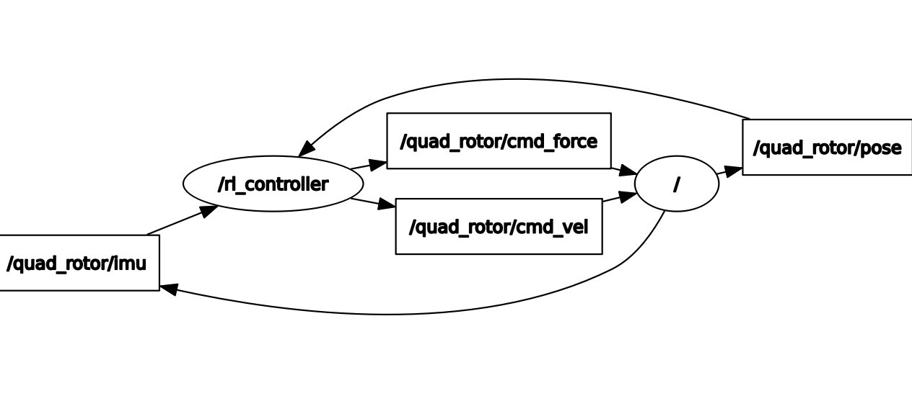
ROS Architecture Schematic:
<number>

Slide 6
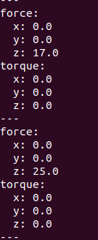
Basic Architecture:
- IMU node : Position, Velocity, Acceleration
- RL Node: Thrust Force, Linear Velocity
- Action_space: Thrust Force (From DQN)
- Linear Velocity: Constant Throughout
<number>

Slide 7
Simulator Demo:
<number>

Slide 8
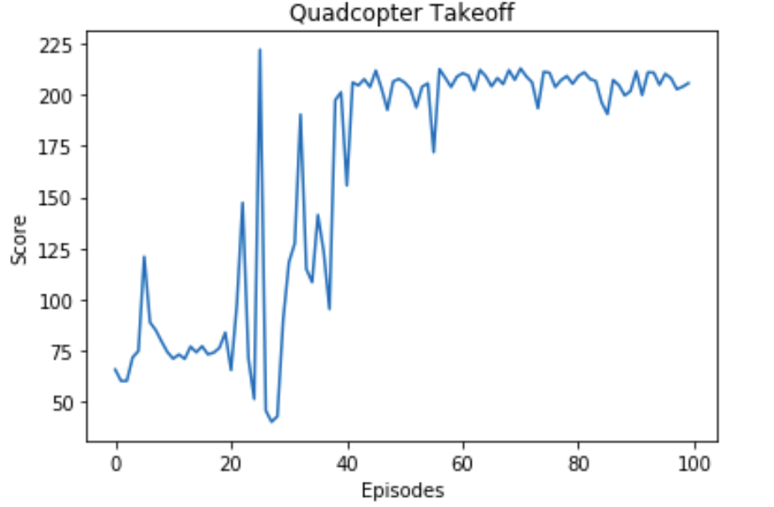
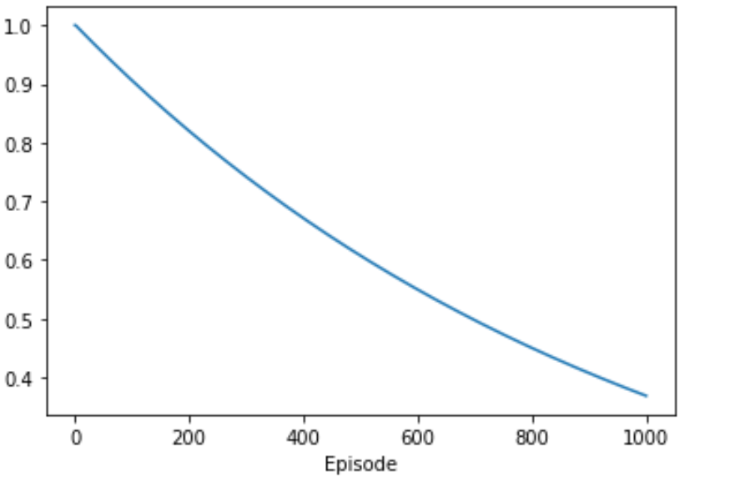
DQN learning for Takeoff
Learning rate = 0.001
Epsilon = 1
Epsilon decay = 0.995
Batch size = 64
Number of episodes = 64
Discount factor = 0.9
1

Slide 9
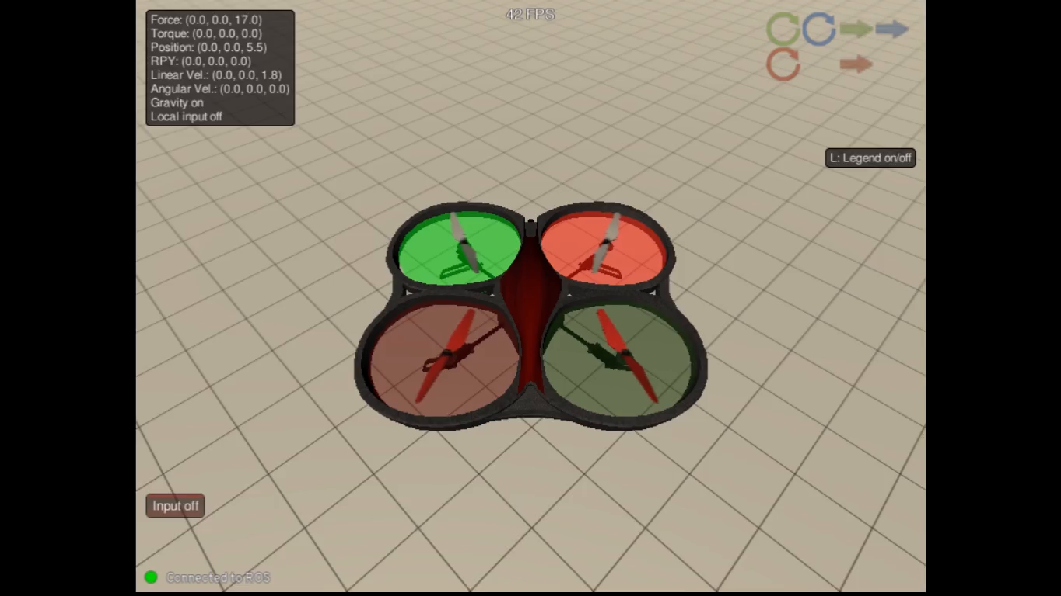
Takeoff demonstration
1

Slide 10
Hovering
State : Quadcopter position and linear acceleration from simulation environment
Action : Control command to quadcopter as thrust force
Reward: Negative absolute distance from quadcopter position till the target height(10 m) minus linear acceleration
Bonus: 10 when distance less than 3 m
Episode termination: 5 s elapse(penalty -10)
1

Slide 11
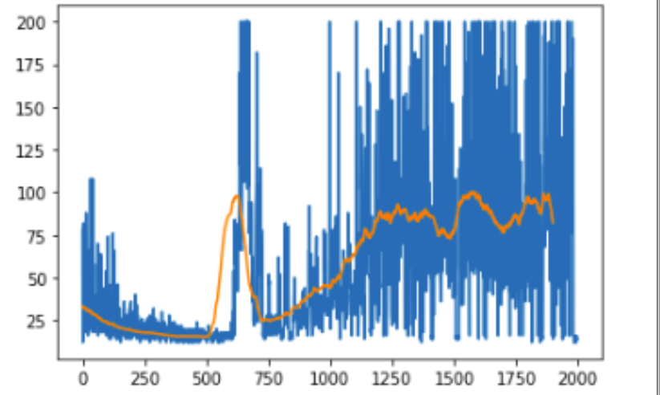
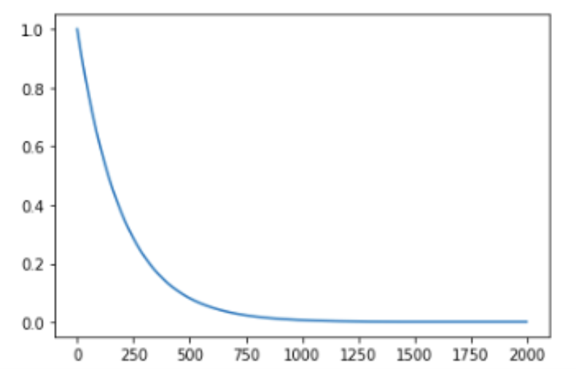
DQN learning for Hovering
Learning rate = 0.001
Epsilon = 1
Epsilon decay = 0.995
Batch size = 64
Number of episodes = 64
Discount factor = 0.9
1

Slide 12
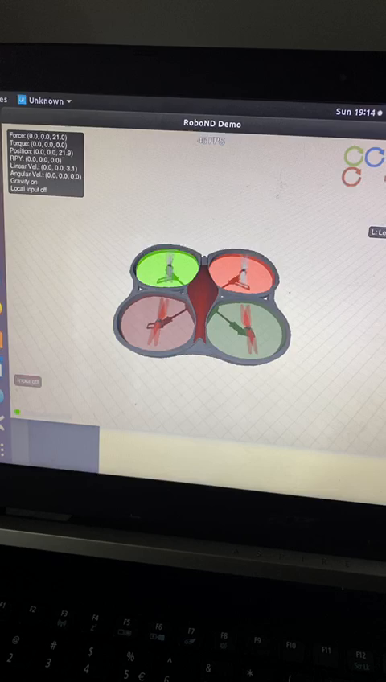
Hovering demonstration
1

Slide 13
Conclusion
DQN is clearly capable of learning direct thrust (force) control to perform takeoff and landing in 1 DoF dynamics.
The simulated environment is computationally frugal to apply extensive learning in complicated experiments (in the future)

Slide 14
Future Works
Gradually introduce more degree-of-freedoms to increase the fidelity of the dynamics
Import more accurate inertia models, introduce aerodynamics and energy models
Advanced RL algorithm (PPO) scheduled to replace DQN

